Slide 1

UNT FAQ Response SYSTEM
Group ???
CSCE 5290- NLP
Guided by – Dr. Jayanth Muthukudage

Slide 2
Team Members
→
→
→
→
→

Slide 3
Objective
Our main objective of this presentation is to showcase our achievements of our project , focused on implementing a question answering system:
1. Using vast information available on UNT websites(FAQs) – Data Collection.
2. Understanding and implementing the DistilBERT model – Model Implementation.
3. Highlighting implementation specifics, encountered challenges, and obtained results – Challenges and Results.
4. Future Work.

Slide 4
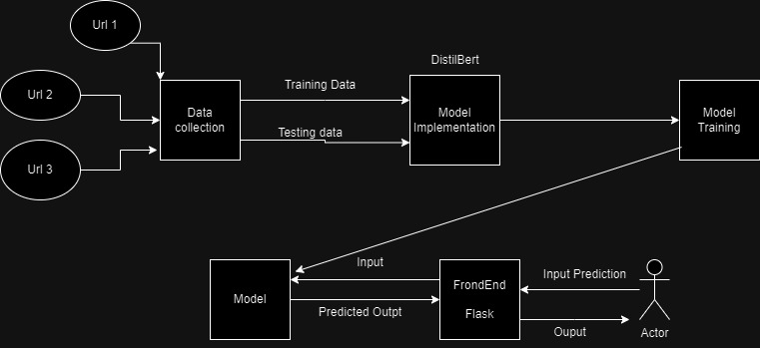
Flow CHART

Slide 5
DATA Collection
→ URLs Identification: We initiated the data collection by identifying 11 distinct URLs hosting FAQs from various facets of the University of North Texas (UNT), having departments, services, and resources.
→ Efficient Scrapping : By utilizing the Beautiful Soup module, a well-known Python web scraping technique, we were able to efficiently parse HTML text and extract FAQs from the indicated URLs by methodically retrieving data.

Slide 6
DATA collection
→ Python Libraries Integration: Two crucial Python libraries were incorporated into our data scraping process with ease: 'Beautiful Soup' for parsing and'requests' for creating connections and obtaining HTML information.
→Customized Extraction Functions: These functions, which were designed to extract questions and answers from corresponding HTML tags, demonstrated a methodical and flexible approach to data extraction.
→Structured JSON Formatting: We organized the gathered data into a common JSON format as the last step in the data collection process. In line with the needs of the model implementation,

Slide 7
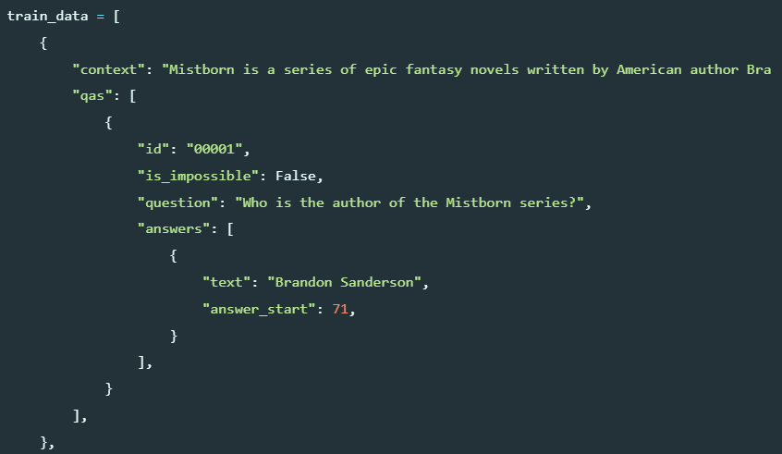
DATA Format
Contex:
Description for Question and Answer.
Qas: list of Q&A
Id: id for each Q&A
Question: Question asked.
is:_impossible: Is the answer present in the question.
Answer: Answer for the question.

Slide 8
Model Implementation
→ For implementation of mode we used simpletransformers library which supports variety of Question Answering models. We used pretrained DistilBert model because enables us to transfer knowledge for previous data.
→ Code for Model Initialization:
from simpletransformers.question_answering import QuestionAnsweringModel, QuestionAnsweringArgs
model = QuestionAnsweringModel(
model_type,model_name, args=train_args
)
model.train_model(train, eval_data=test)

Slide 9
Model fine tuning
→ simpletransformers library provide a great functionality to perform hyperparameter optimization with Simple Transformers and W&B Sweeps.
→ The AI developer platform, Weights & Biases (W&B), provides tools for training, optimizing, and utilizing foundation models.
→ With the help of Sweep configuration we can configure different sets of hyperparameters for improving the model.

Slide 10
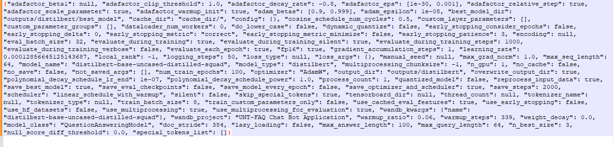
TUNED parameters
→ The tuned parameters are stored in config.json file in the project folder

Slide 11
Performance
→ The Training_loss is approaching to zero which means that the model loss is good during the training.
→Similar means how closely the generated answers are closely related to original answer. Around 61-62 answers are predicted to be similar during sweeping for every iteration. This tells that the model should be trained more with iterations and with sufficiently clean data.
→ There are no exact matches because of long length of answers and less training, even a difference in spacing is considered incorrect predictions.

Slide 12
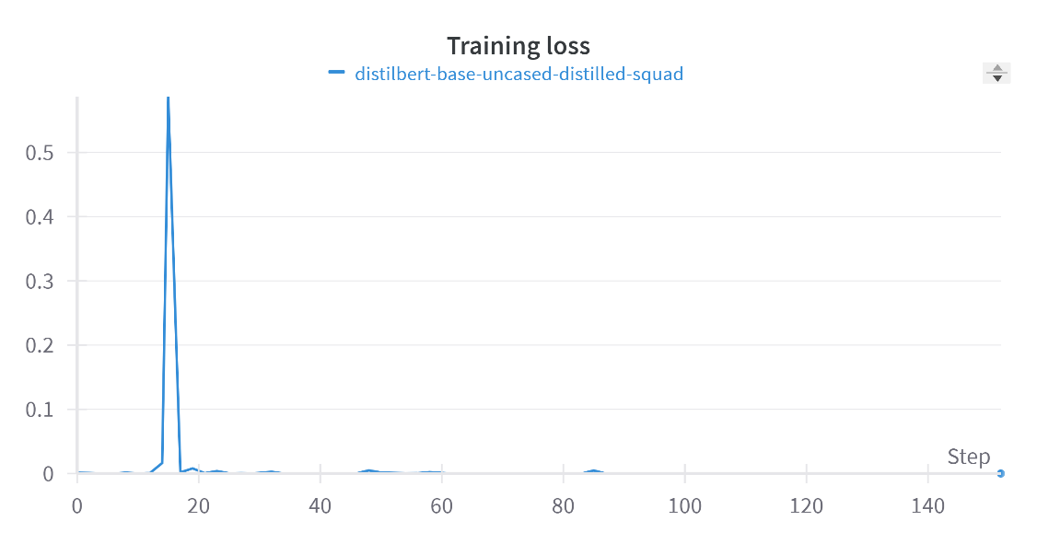
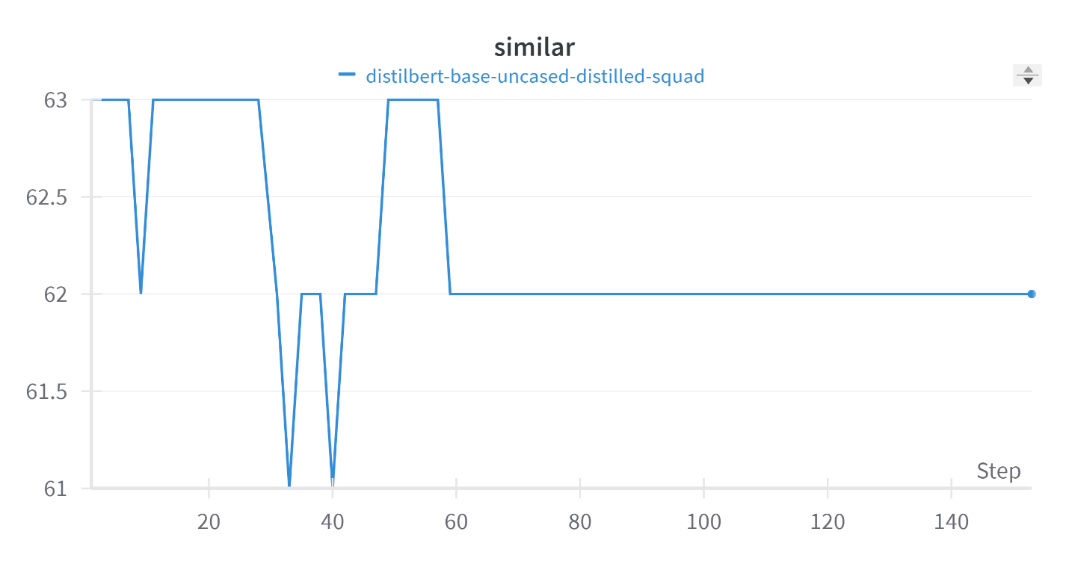
Training Loss & Similar

Slide 13
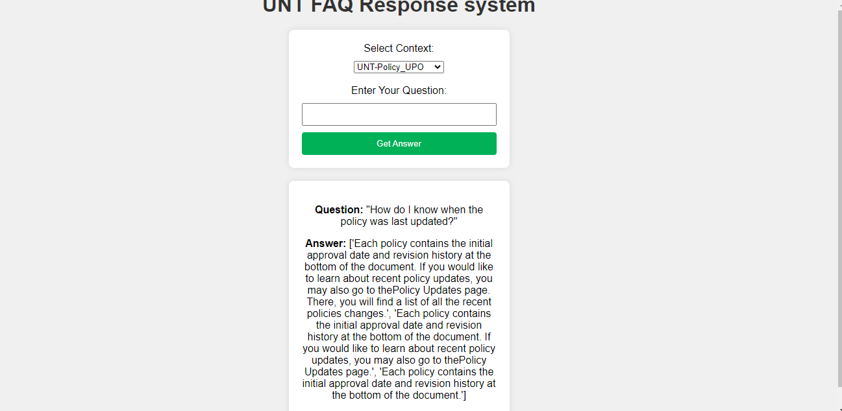
Output 1

Slide 14
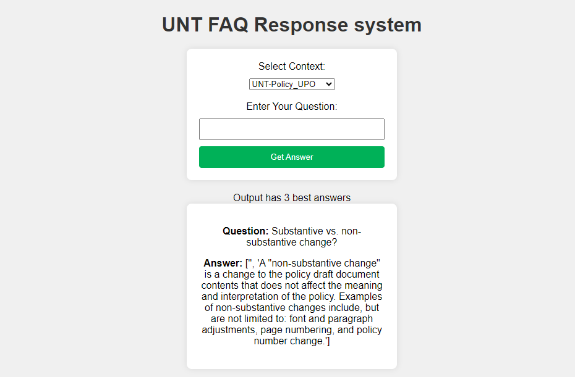
Output 2

Slide 15
Assumptions
→ We assume that context for each FAQ is concatenated answers of all the answers which is major assumption that it provides a meaningful information
→ Data preprocessing like removing stop words, punctuations is not required meaning that the model will understand the them.
→ The number of records for training are sufficient for training the model.

Slide 16
Challenges
→ The unavailability of higher ram GPU for further fine-tuning model which is important for improve the performance.
→ Including meaningful context in the data is a tough job because its hard to manually include for more number of number of example.
→ Having more number of records is quite complicated because we need to customize scrapping for each task.
→ Most of the FAQs are independent of each other so it hards devolope a context that fits all the Question.

Slide 17
Conclusion & Future Work
→In conclusion, we have successfully developed the required model and UI for the Question Answering task.
→Based on the results we understood that the model needs to be trained more and data must be more meaningful.
→ As beginner students in Natural Language Processing (NLP), we have comprehensively grasped the intricate flow involved in developing a Transformer model.
→In future we need to concentrate more on dataset, having a greater number of records and having more meaningful context for the data.
→ Increasing performance by fine tuning the model.

